Slide 1


Development of MCQ System
Module Project
Module: Programming Foundations
Course: Applied Degree in Software Engineering
Start Date :
End Date :
Submission Date :25-11-2022
Learner Name
Enrollment ID
: Syukur Sidiq Nur Alam
:bdse-0922-089
Presentation Date :

Slide 2

Document History
Version Number | Effective Date of release | Summary of Included Changes | Author
1 | 1 Jul 21 | First Edition | Jeyashree
2

Slide 3
Contents
Project Definition
Project Deliverables
Project Milestones & Tasks
Project Environment
Tools
Project Design
Classes & Methods
Steps from Coding to Execution
Development Process
Coding Standards
Milestone Feedback & Action Taken
Project Results
Proposed Improvements

Slide 4
1. Project Definition
Project Objective
Design, Implement, and Test MCQ System using Java.
Implement an application using IntelliJ or Eclipse.
Determine the debugging process and explain the importance of a coding standard
Proposed Solution
The system should handle multiple sets of MCQs. For example, Java Basics,
Control Structure, HTML Basics, etc.
Using The OOP Paradigm with Class and Method
The MCQ Test must easy to use

Slide 5
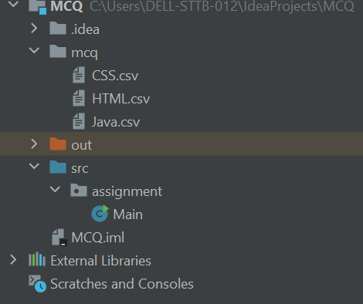
2. Project Deliverables
Project Deliverables
CSS.csv
HTML.csv
Java.csv
Main.java
List of Evidences

Slide 6
3. Project Milestones & Tasks
Project Task ID | Project Task Description | Project Milestone ID
1 | Create Requirement Specification | 1
2 | Develop Algorithm | 1
3 | Analysis and Design | 2
4 | Create the Application | 2
5 | Test the Application | 3

Slide 7
4. Project Environment
Technical Environment and Tools Used
Java JDK-18.0.2.1
Laptop Dell Latitude 3420
IntelliJ IDEA
Windows 11
List of references
LinkedIn E-Learning
YouTube
W3School

Slide 8
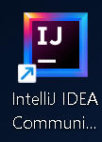
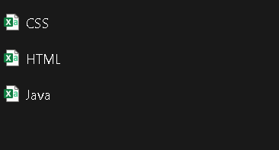
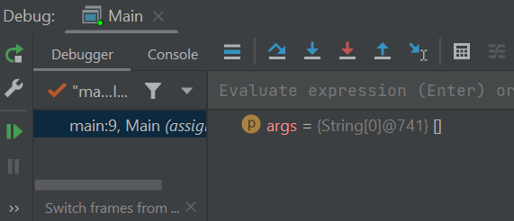
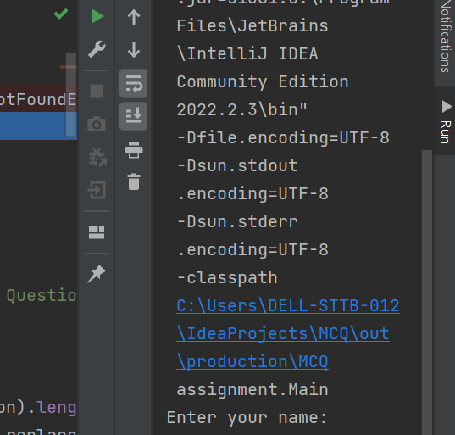
5. Tools
Screen capture of various tools used
*Writing Code Tools
Intellij IDEA
*Debugging Tools
Intellij IDEA
* Run Tools
Intellij IDEA
excel

Slide 9
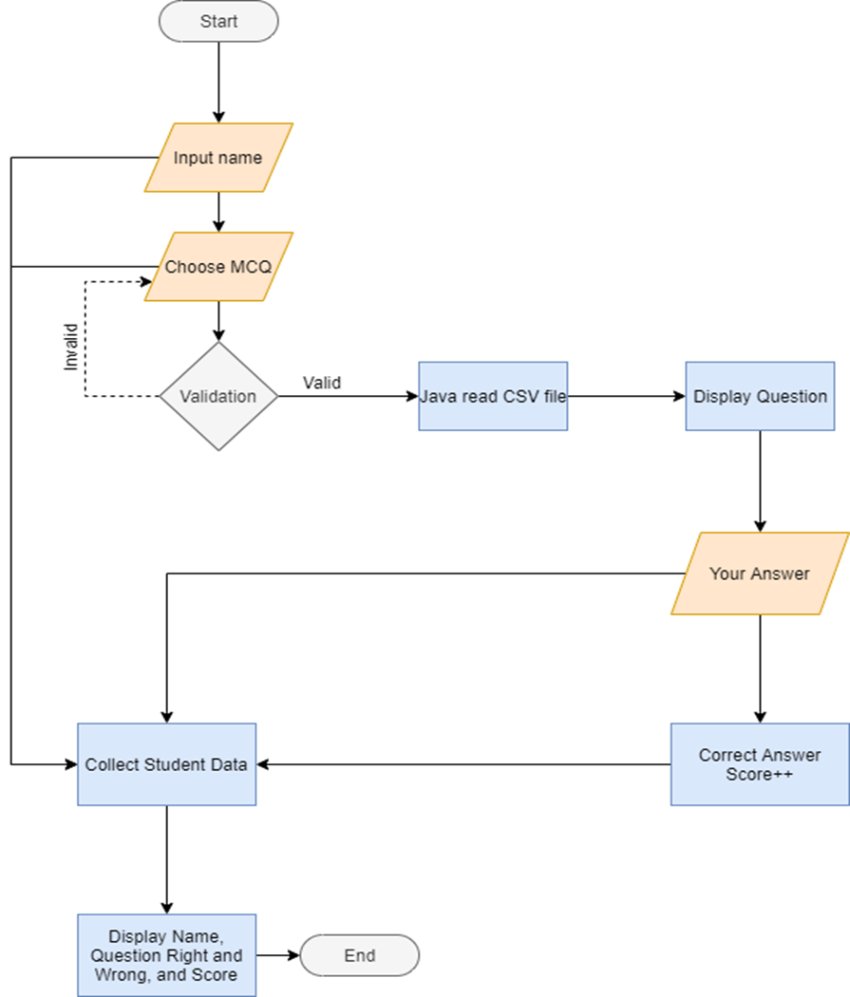
6. Project Design
System Design

Slide 10
7. Classes & Methods
* Main
Methods
*Equals
*toLowerCase
List of Classes & Methods used

Slide 11
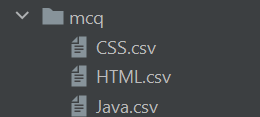

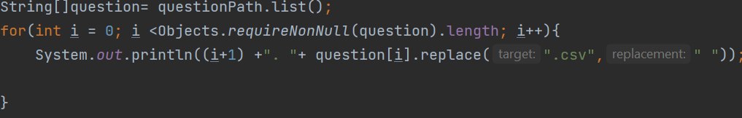
8. Steps from Coding to Execution
1. Create csv file in Microsoft Excel to create MCQ
2. Create a folder to store MCQ file
3. Create file Main.java
4. Then create program to read the MCQ file
5. After read the file create program to display the question MCQ
Application execution methods

Slide 12
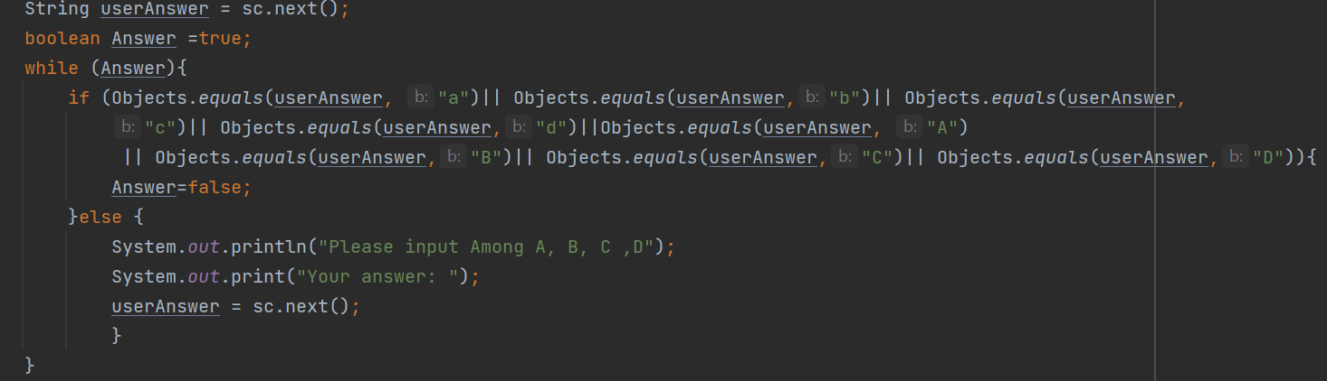
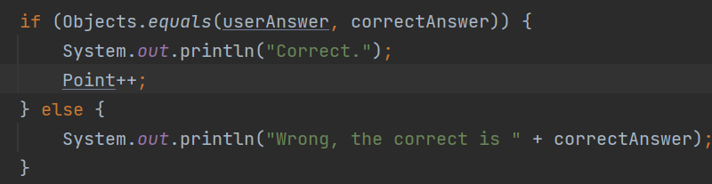
6. Create Scanner to user input the answer
7. Create program to check the correct answer and check the total score from student

Slide 13
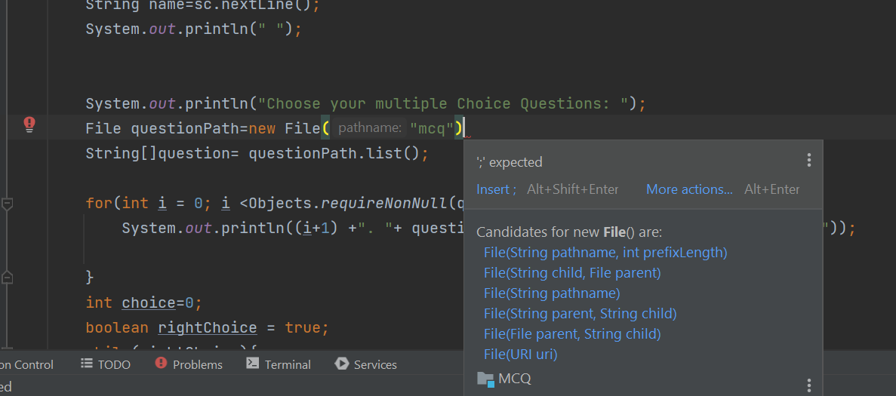
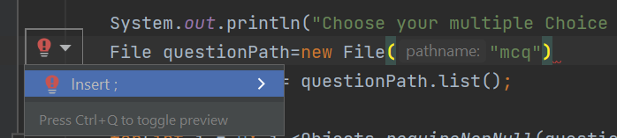
9. Development Process
❑ Development using IDE and Debugging Mode
The IDE will make a suggestion along these lines if there are any coding issues
If the code changes to "red" and the red lamp appears, we can follow the instructions to make the code correct itself as shown here.

Slide 14
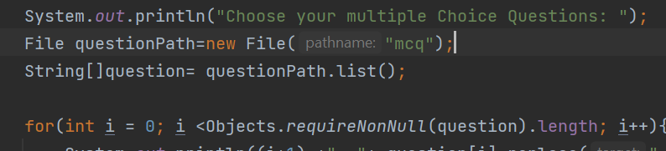
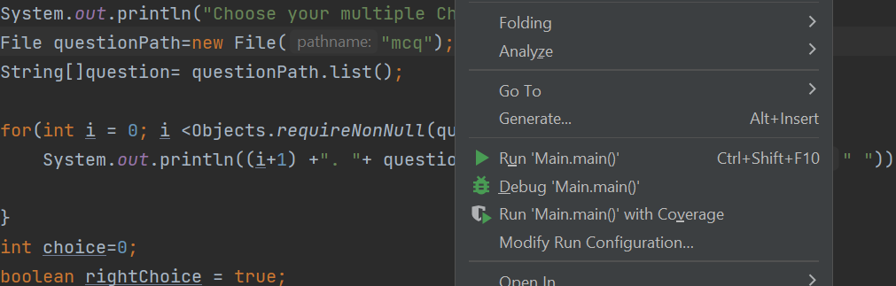
The code is now fixed
Debugging the program typically has problems and mistakes, which are often fixed. Debugging is the process of correcting a software bug. To debug the software, set a breakpoint and right-click on the red line. You then select the debug menu

Slide 15
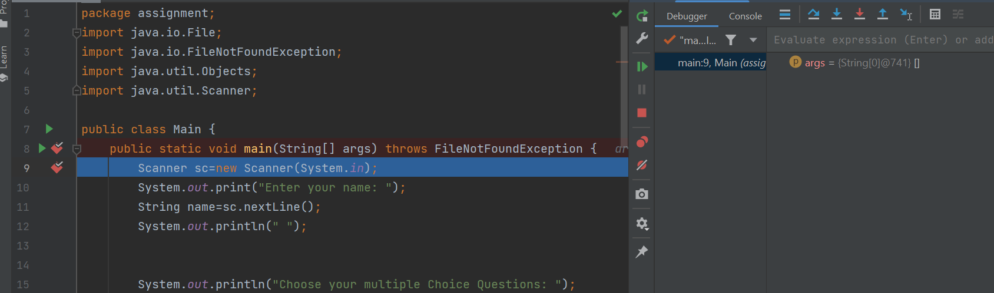
After that the program will debug and show you the result. If checklist, the program work clearly

Slide 16
10. Coding Standards
`
Application of coding standards
Coding Standard for class:
The class name must be use Camel Case
If the name more than two word, the first letter must start with uppercase
Coding Standard for variable:
The name should start with lowercase letter
If the class name is more than two words, the first letter must start with lowercase and next word must uppercase.

Slide 17
11. Milestone Feedback & Action taken
Project Milestone ID | Milestone Feedback received from Tutor / Learning Facilitator | Action Taken (Yes / No)
1
2
3

Slide 18
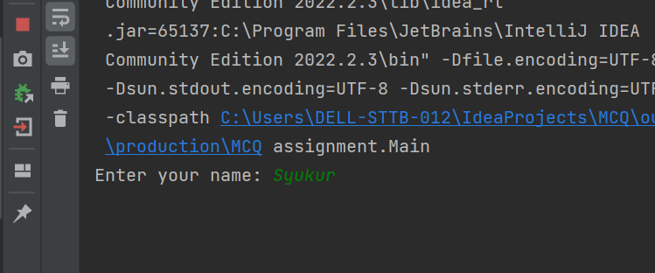
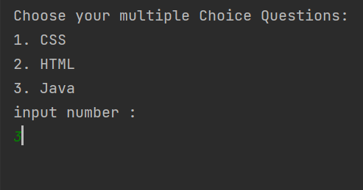
12. Project Results
Screen Shots of Evidences
User can Input their name
After that the sytem will show The MCQ Test Set and User can choose The MCQ.

Slide 19
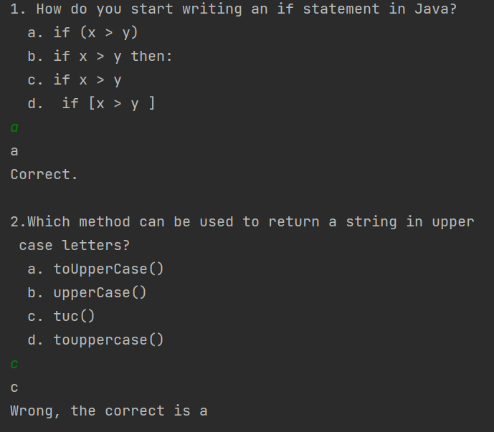
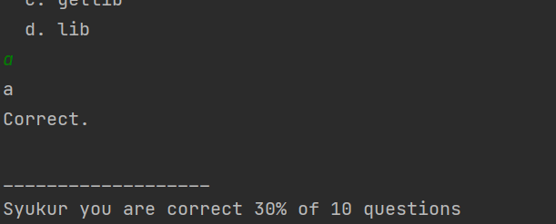
Next, the question will show with the option. If your answer is right, there will be some validation and if you are wrong answer also have validation.
In the last thing after user finish do the test. The Score will come up.

Slide 20
13. Proposed Improvements
List of Improvements
I will tidy up by adding classes and methods

